Slide 1
MINESWEEPER
DONE BY BATCH-12
G. VARUN- 1602-17-737-054
P. SAI VENUNATH-1602-16-737-038
K. LAKSHMIBHAVANI -1602-17-737-015

Slide 2
GAME OVERVIEW
Minesweeper is a single-player puzzle video game. The objective of the game is to clear a rectangular board containing hidden "mines" or bombs without detonating any of them, with help from clues about the number of neighboring mines in each field.
The game originates from the 1960s, and has been written for many computing platforms in use today. It has many variations and offshoots.

Slide 3
The player is initially presented with a grid of undifferentiated squares. Some randomly selected squares, unknown to the player, are designated to contain mines.
Typically, the size of the grid and the number of mines are set in advance by the user, either by entering the numbers or selecting from defined skill levels, depending on the implementations.

Slide 4
GAME RULES
The game is played by revealing squares of the grid by clicking or otherwise indicating each square.
If a square containing a mine is revealed, the player loses the game. If no mine is revealed, a digit is instead displayed in the square, indicating how many adjacent squares contain mines; if no mines are adjacent, the square becomes blank, and all adjacent squares will be recursively revealed.

Slide 5
The player uses this information to deduce the contents of other squares, and may either safely reveal each square or mark the square as containing a mine.
The game is won when all mine-free squares are revealed, because all mines have been located

Slide 6
MODULES
Difficulty()
Play()
Initalise()
Placemines()
Isalpha() >isvalid()
Ismine()
Replacemine()
Playminesweeper()

Slide 7
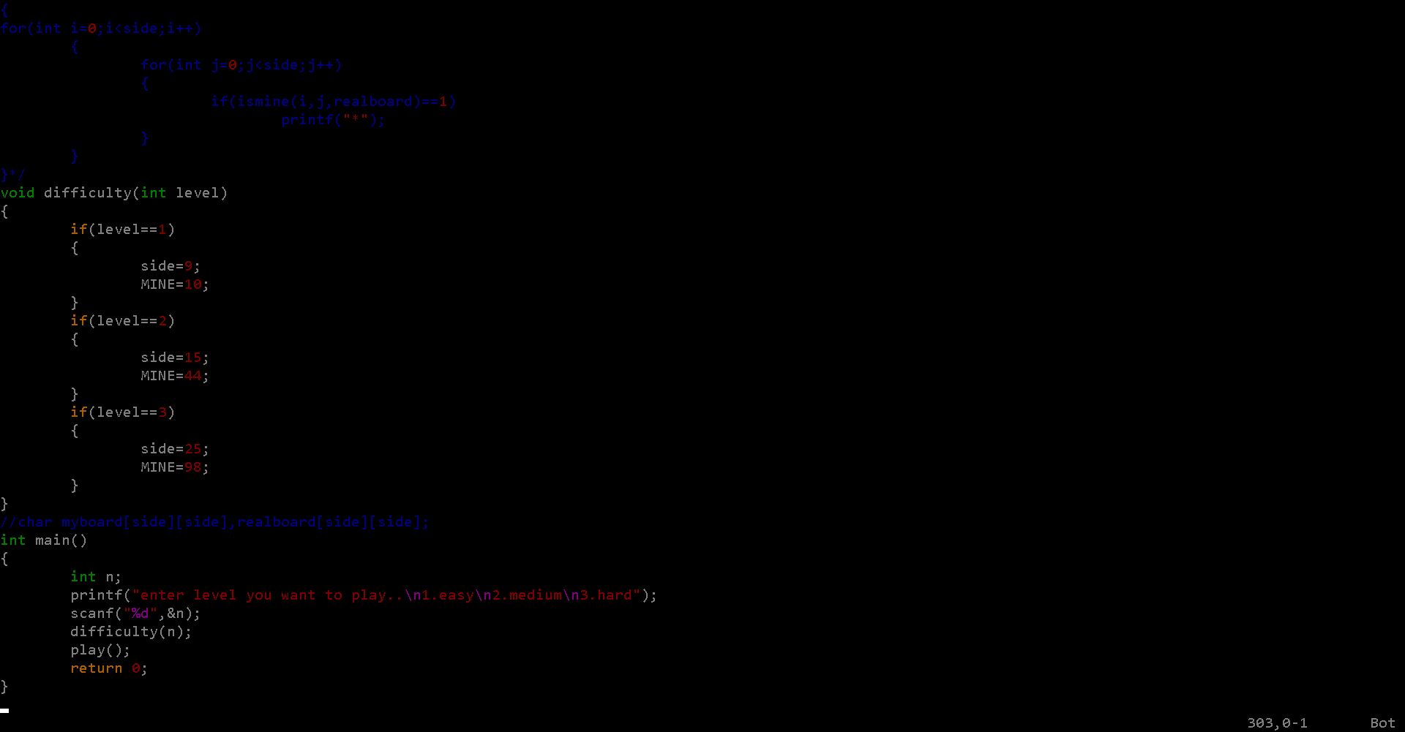

Slide 8
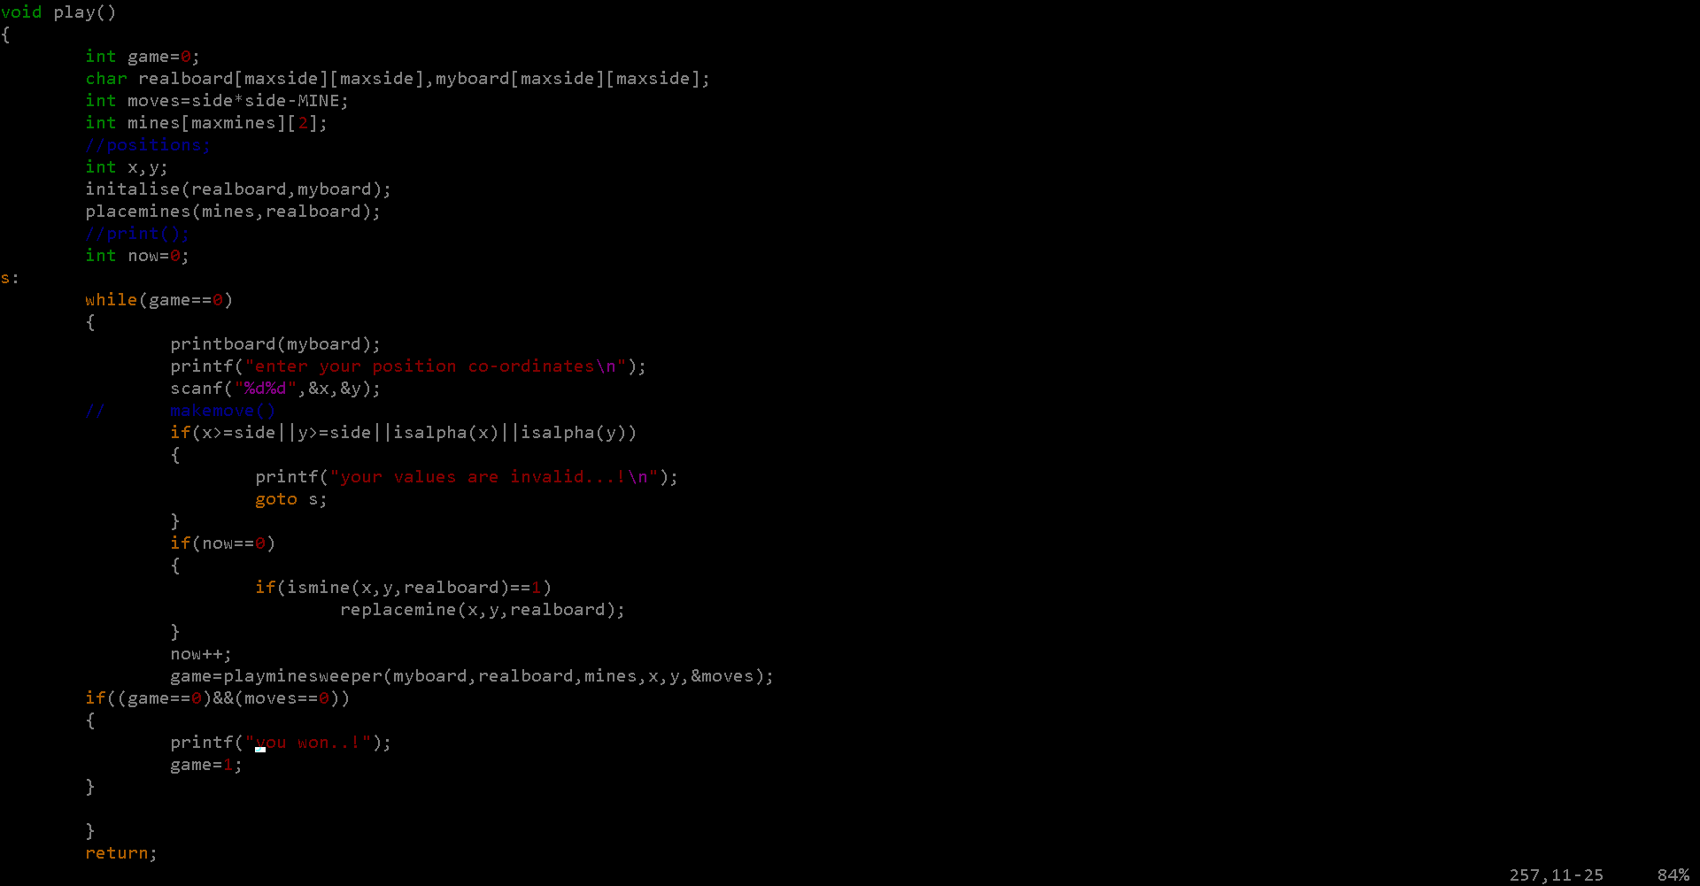

Slide 9
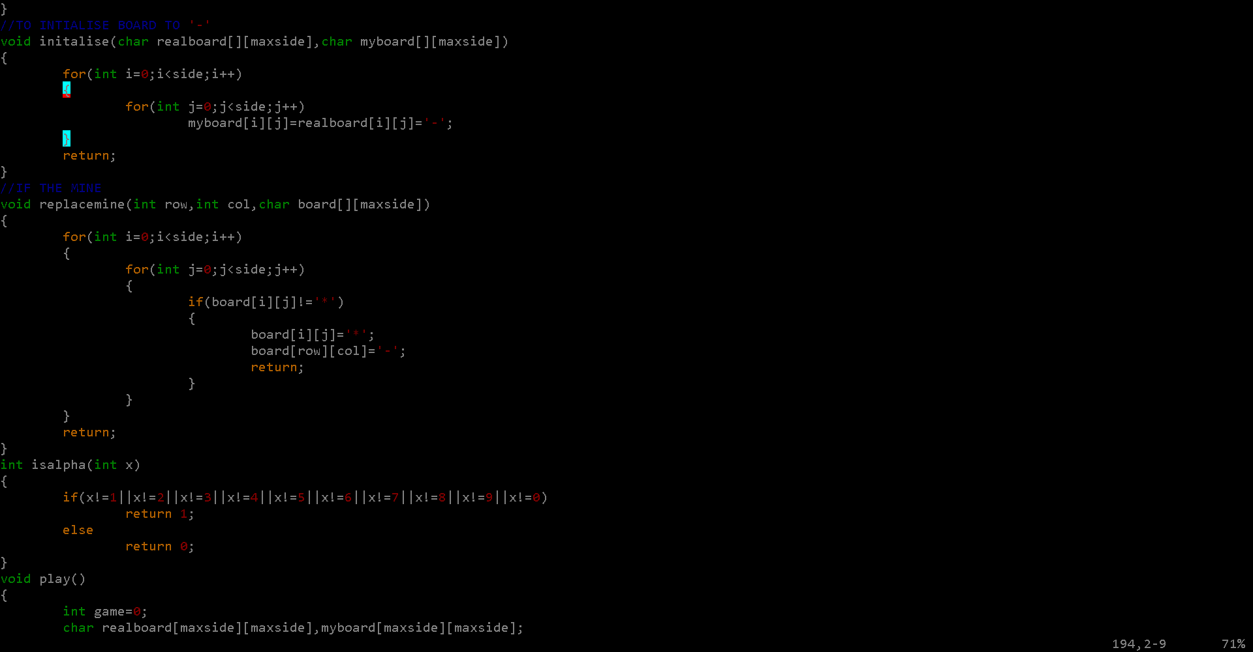

Slide 10
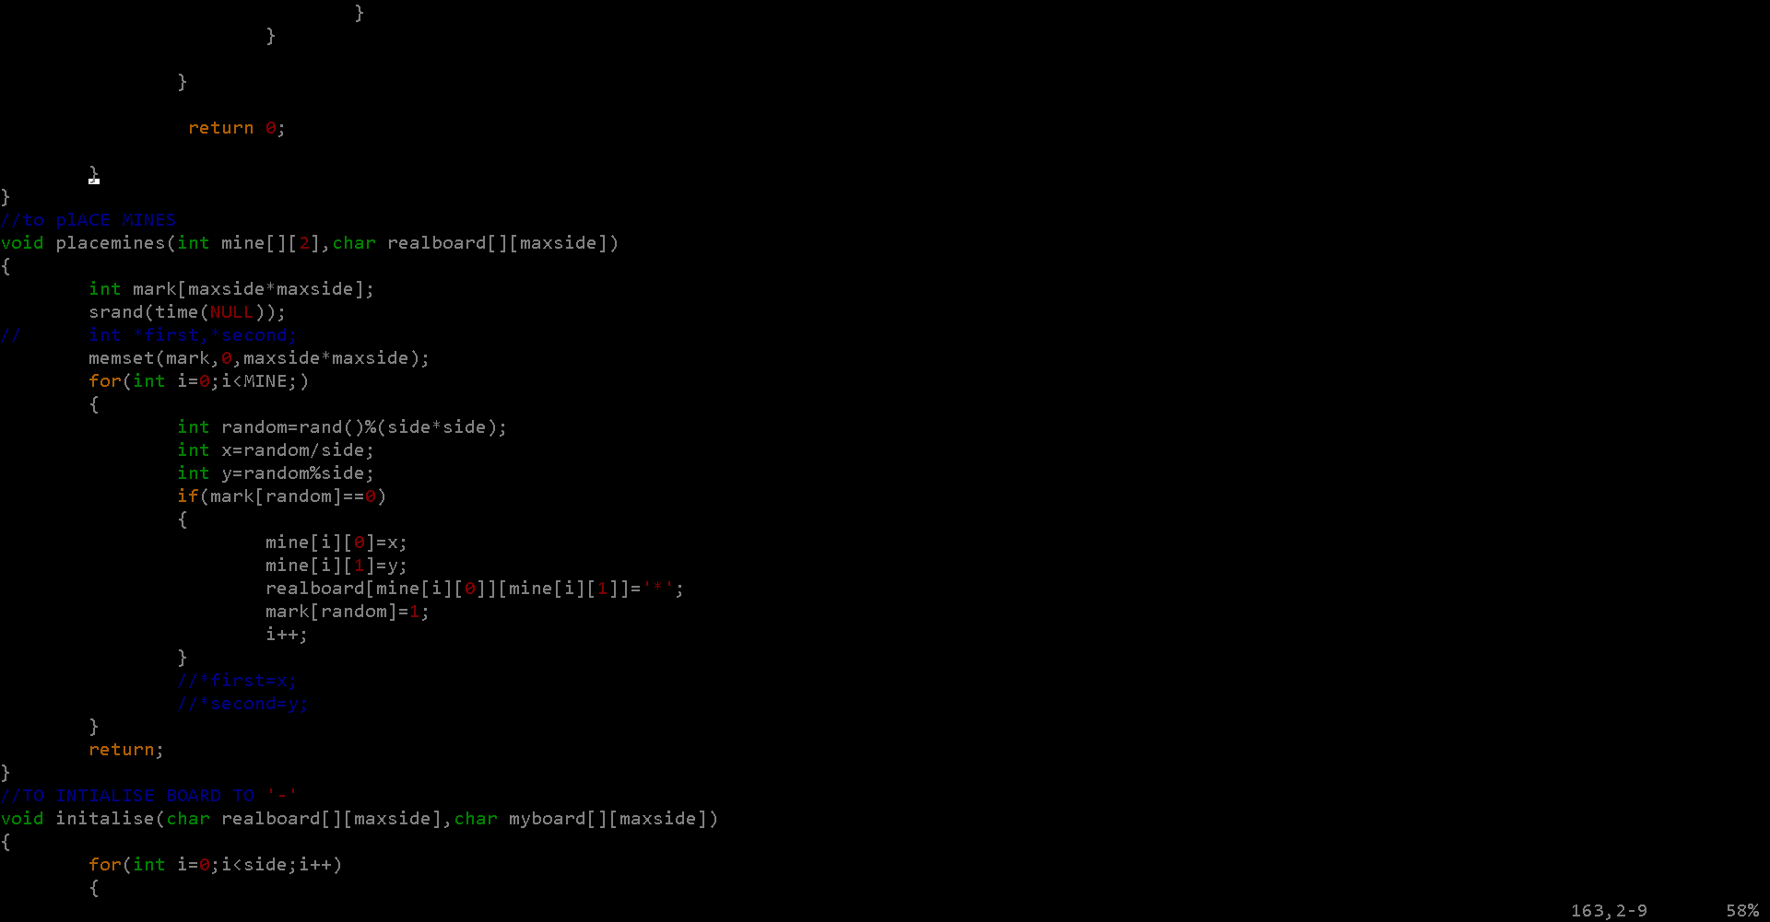

Slide 11
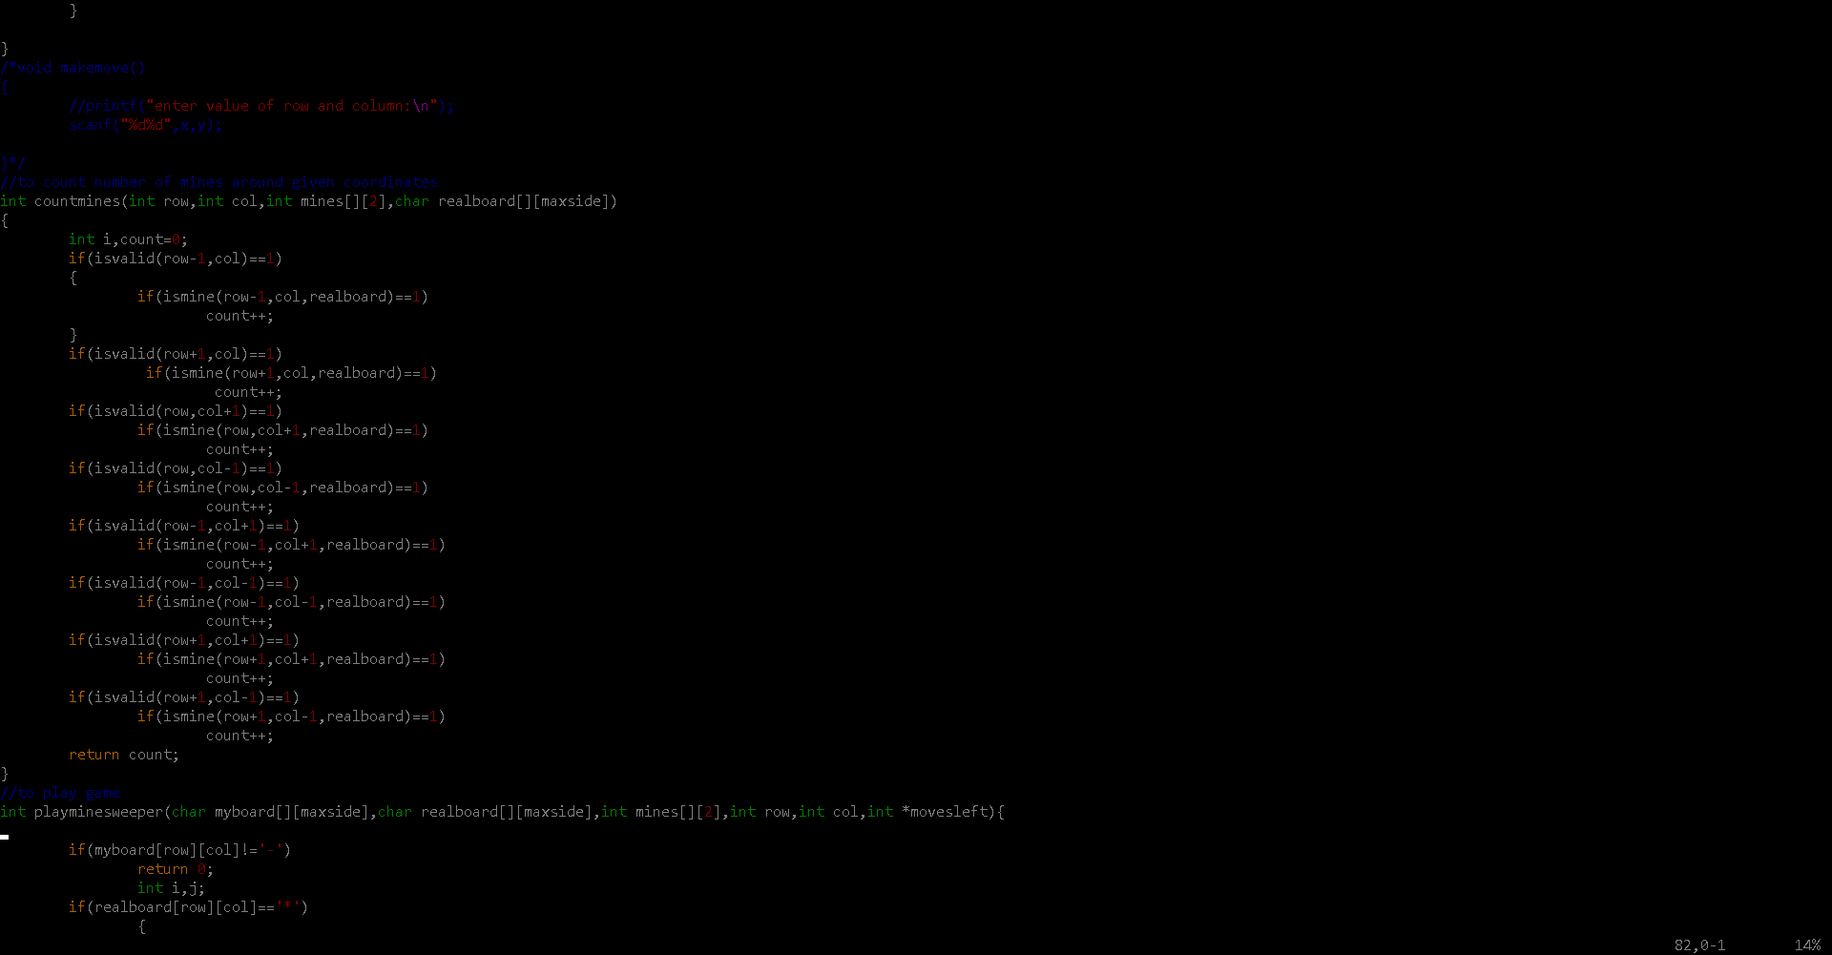

Slide 12
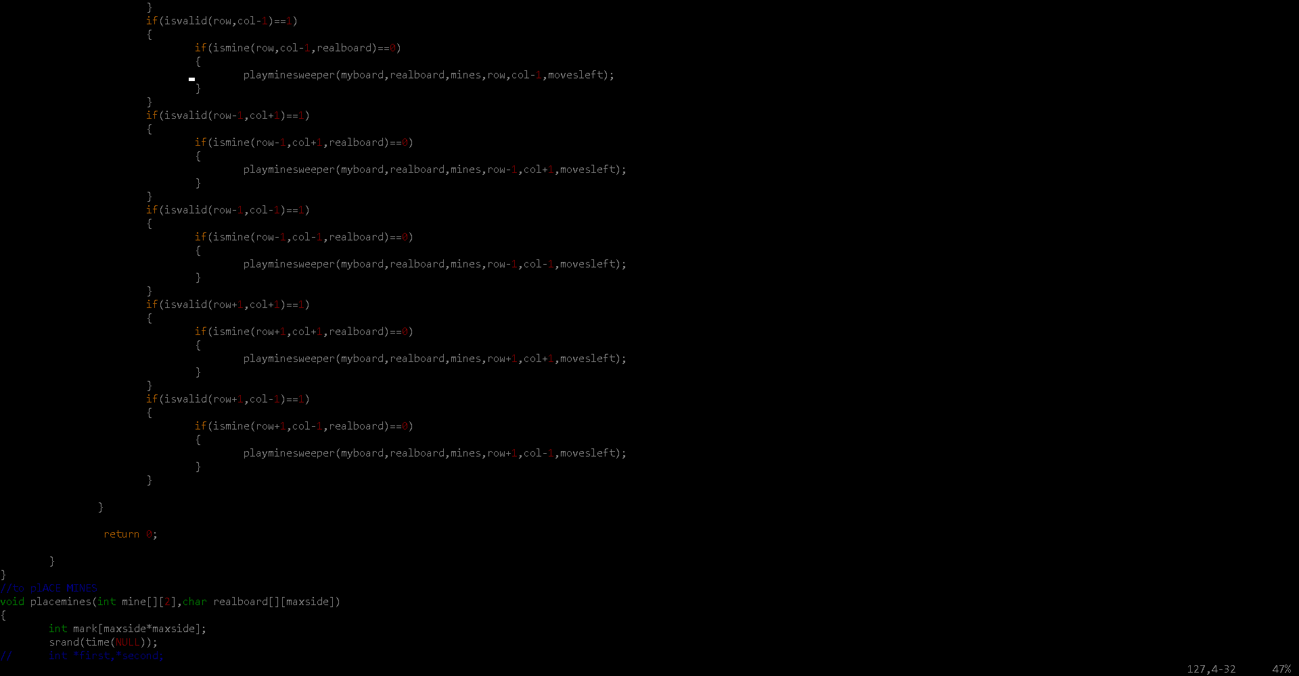

Slide 13
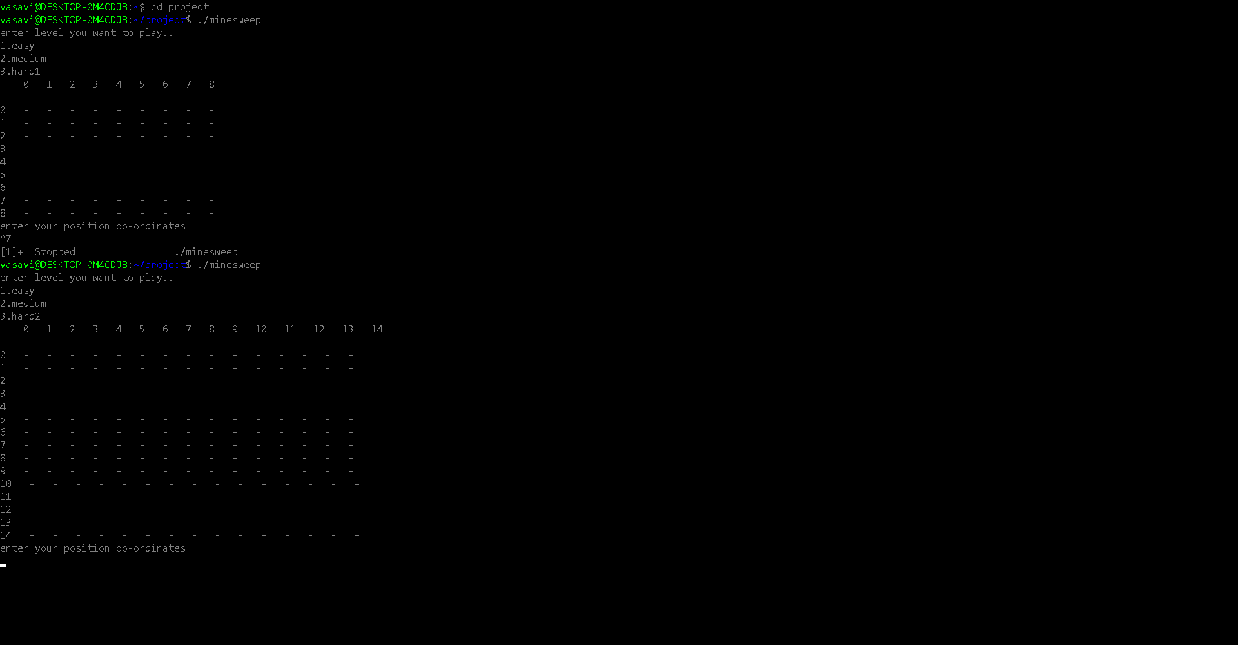

Slide 14
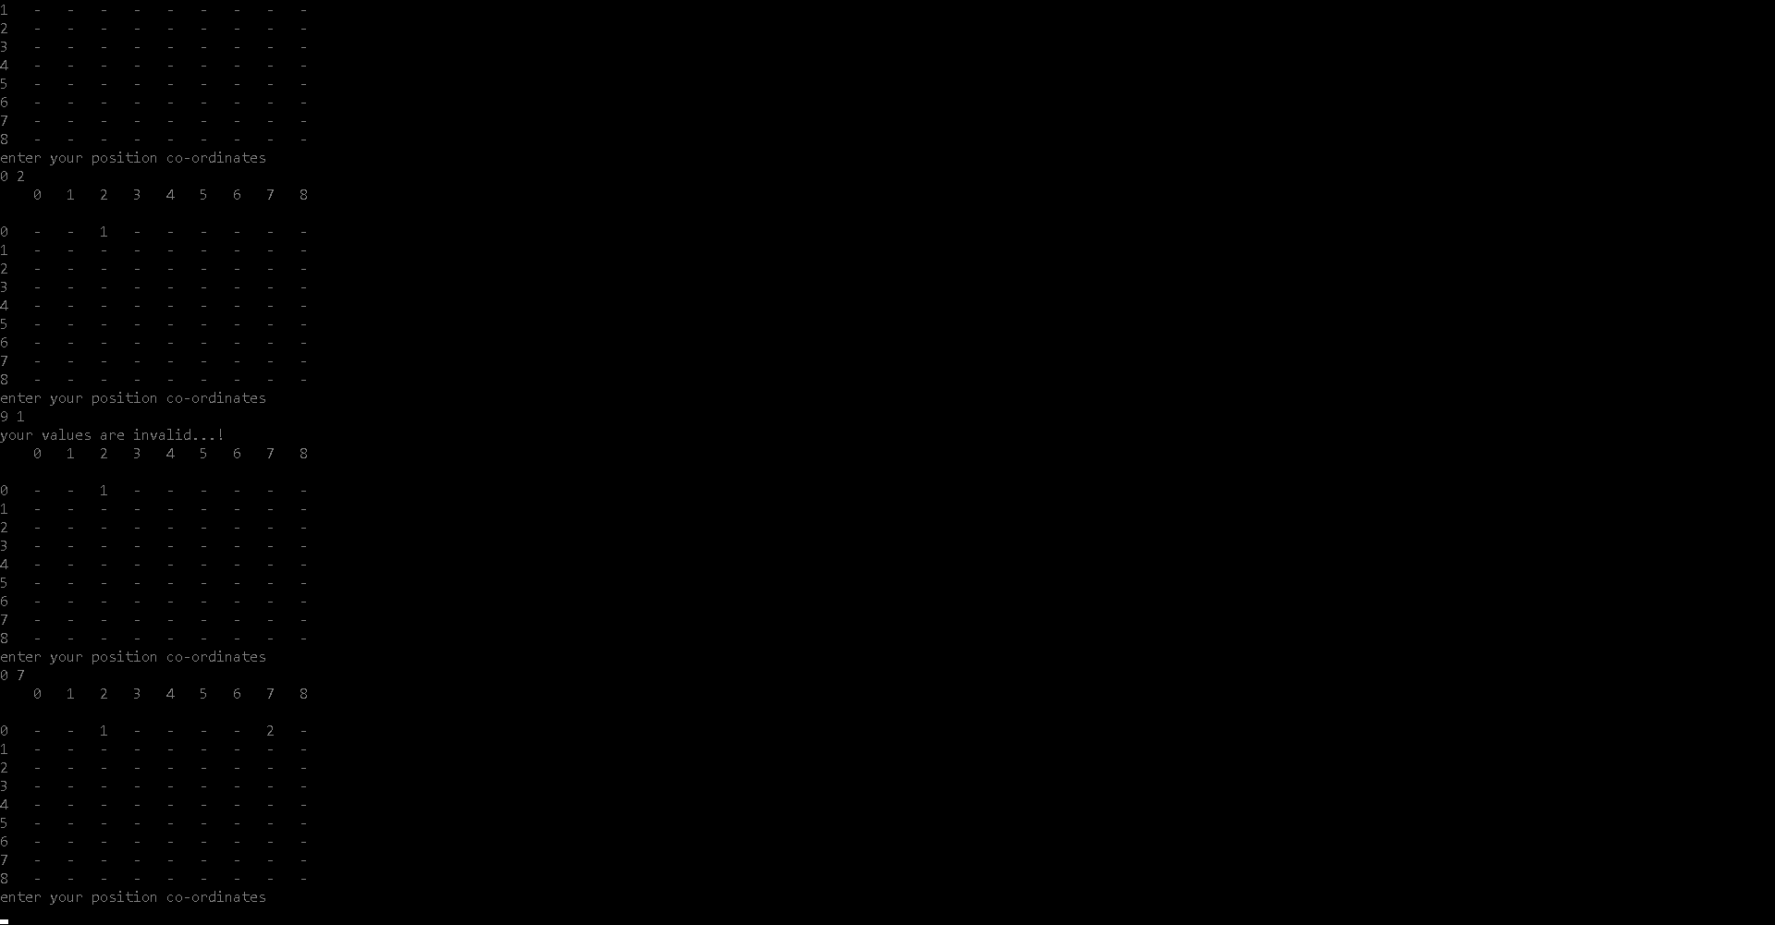

Slide 15


